Slide 1
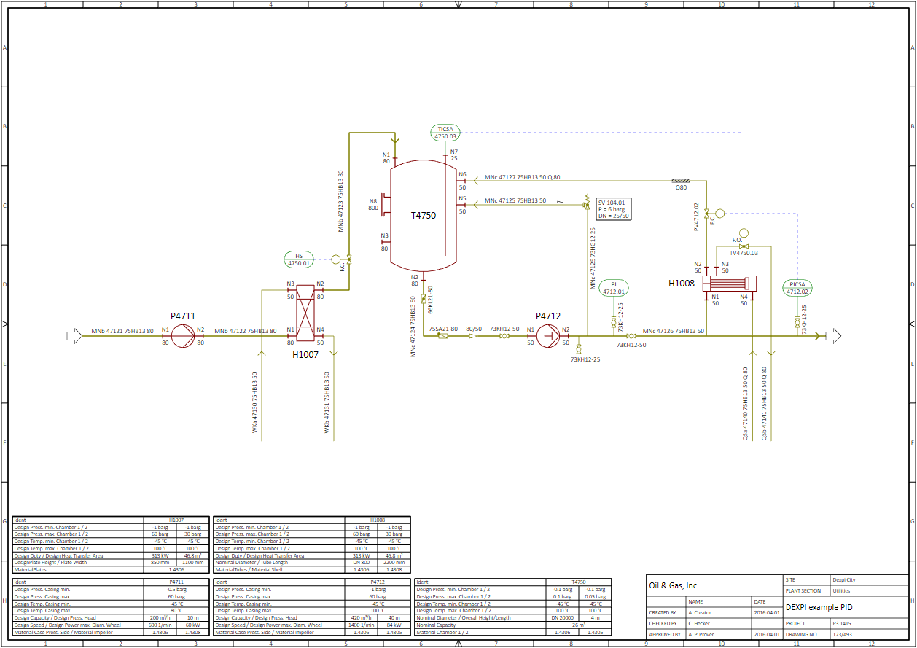
C01V04
This is the full DEXPI Reference P&ID.
Alle Disciplines are included:
Equipment
Piping
Instrumentation & Electrical

Slide 2
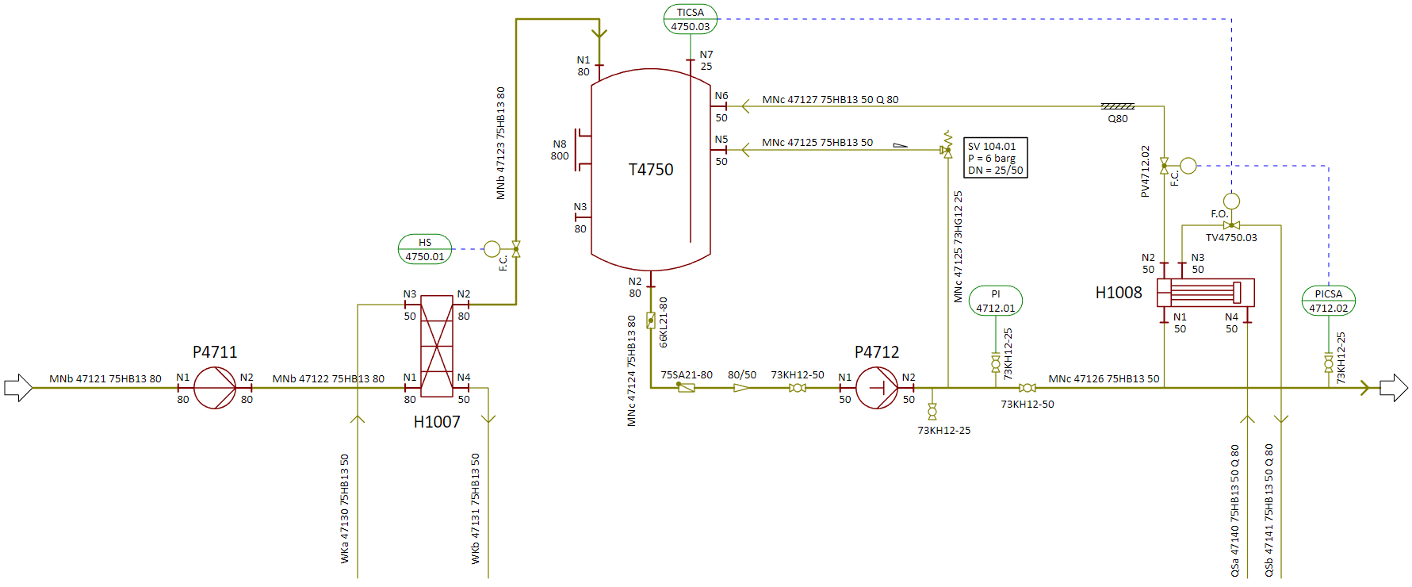
Graphics of C01V04

Slide 3
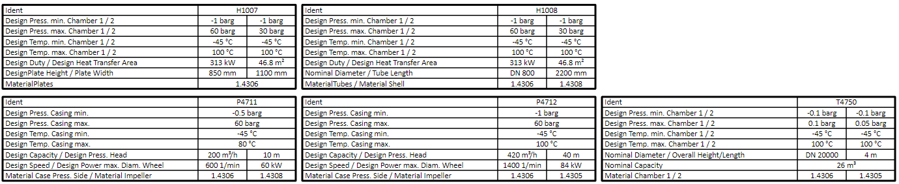
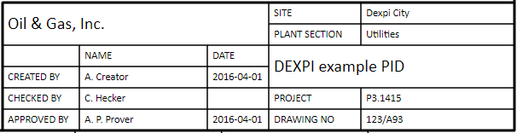
Tables of C01V04

